Slide 1

The PICARD
Abdalrahman Afifi
Hunter Lavender
Travis Mueller
Zachary Wildasin

Slide 2
Overview
Platform for Intelligent Computer Algorithm Research and Development
PICARD was developed to set up a distributed system and conduct machine learning research
Each test the user will specify:
Which data sets and algorithms to use
The number of systems running for the test
Hardware parameters
Hardware specifications for each individual node

Slide 3
Problem Statement & Background
Developed by Dr. Tom Devine from West Virginia University
Establishes a virtual cluster of machines to run the experiments while efficiently processing large data sets.
PICARD's frontend user interface will be web-based, allowing for secure monitoring and remote control.
Visualizations will provide hardware usage statistics, significant findings, data analysis, and real-time updates during execution.
Security is crucial for the PICARD's success, so every aspect of the system will be securely configured and maintained.

Slide 4
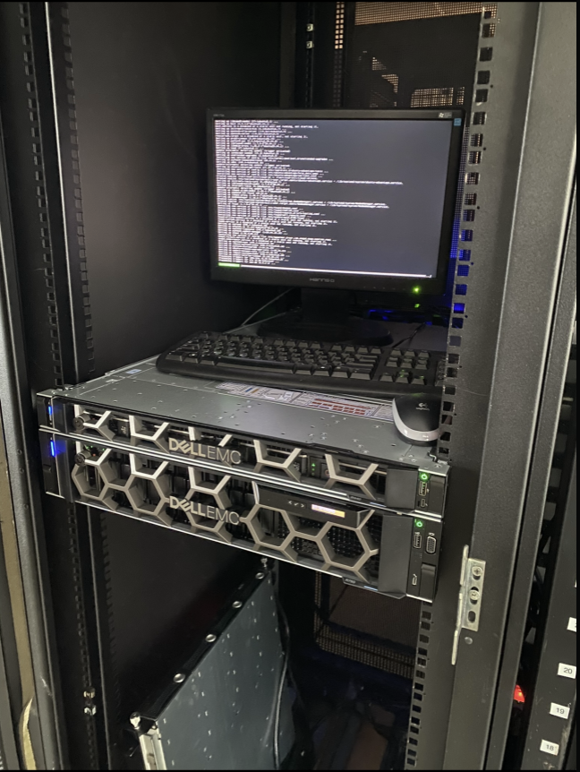
Major Technologies
Server:
Linux Based Server
2 Intel Xeon gold 5218 processors
Docker
Nodes:
Red hat based linux operating system
Apache Spark for distributed data
processing
PICARD server

Slide 5
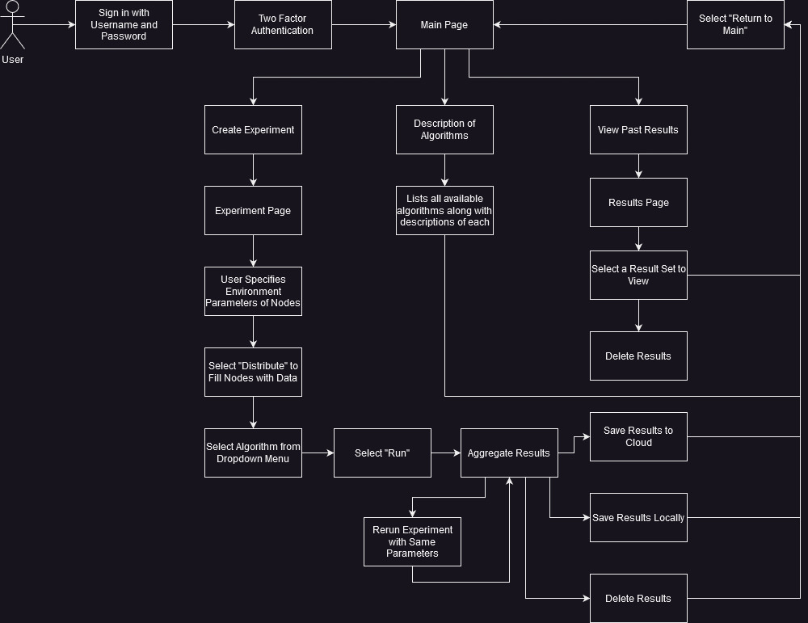
User Interaction

Slide 6
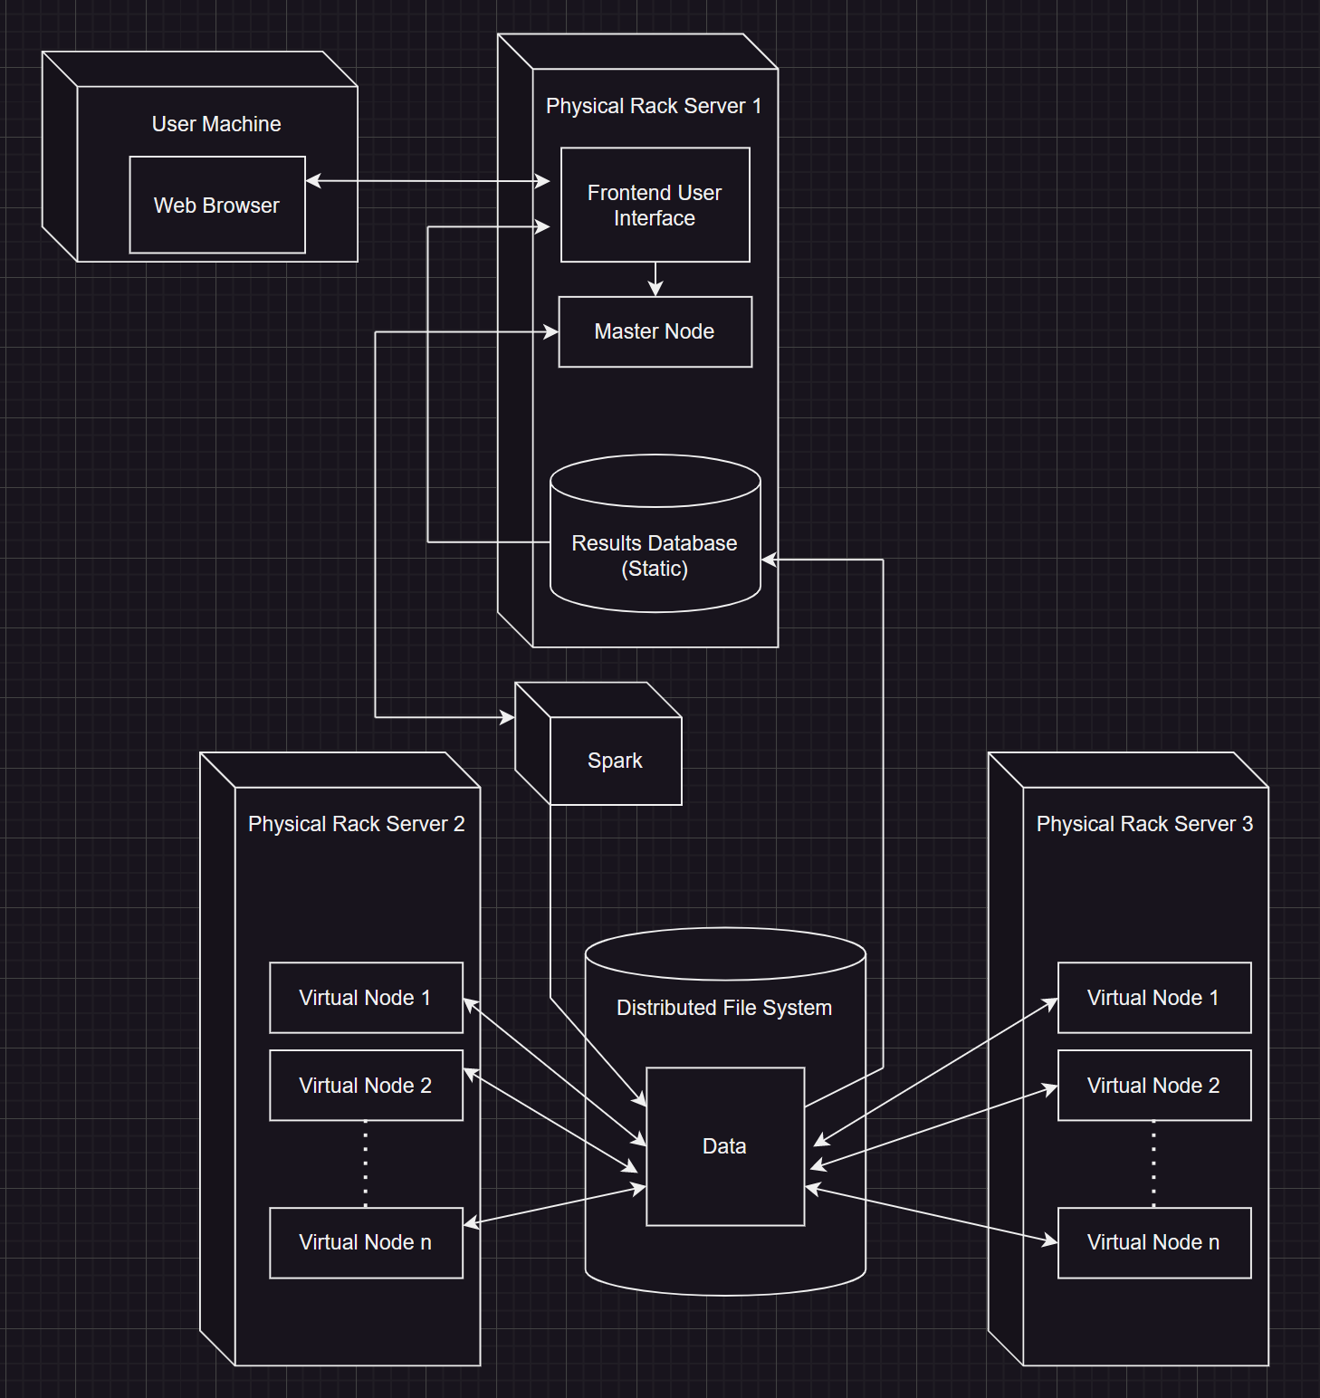
Deployment Diagram

Slide 7
Challenges
Implementing an intuitive Graphical User Interface
Finding balance between normalization and denormalization
Which ensures optimal performance and data integrity
Create scalable systems that grant future researchers flexibility when using the PICARD
Ensuring complete system security for the lifetime of the PICARD

Slide 8
Expected Outcomes
Free and open source software
Secure and user friendly systems
Guarantee smooth execution of experiments with accurate results
Significant completion of user interface upon deployment

Slide 9
Project Plan
Determine the programming language that best aligns with our goals
Frequent debugging during system development
Extensive testing for security vulnerabilities and verifications
Consistent meetings to communicate more effectively

Slide 10
Goals
Full functionality of the user interface along with deployment
User interface is secure and friendly
No major security vulnerabilities
Install additional hardware

Slide 11
Any Questions?

